Slide 1
MATHEMATICS FOR COMPUTING
WEEK 3 - LECTURE
LOGARITHMS AND ROOTS OF POLYNOMIALS

Slide 2
Learning Outcomes
By the end of the lecture the successful student will be able to:
Basic concepts of logarithms
Working with polynomials – addition, subtraction, multiplication and division

Slide 3
Introduction to Logarithms
A logarithm is the power to which a number must be raised in order to get some other number. For example, the base ten logarithm of 100 is 2, because ten raised to the power of two is 100:
log 100 = 2
because
10² = 100

Slide 4
How to Write It?
An example: folding paper
Logarithms characterize how many times you need to fold a sheet of paper to get 64 layers. Every time you fold the paper in half, the number of layers doubles. Mathematically speaking, 2 (the base) multiplied by itself a certain number of times is 64. How many multiplications are necessary? This question is written as:
log₂(64) = x

Slide 5
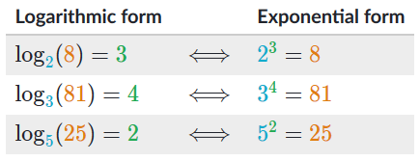
How to Write It?
For instance, the base two logarithm of eight is three, because two raised to the power of three equals eight:
We write "the number of 2s we need to multiply to get 8 is 3" as:
log₂ (8) = 3
Here are more examples of equivalent logarithmic and exponential equations.

Slide 6

Definition of a logarithm
Both equations describe the same relationship between a, b, and c:
b is the base.
c is the exponent, and
a is called the argument.

Slide 7
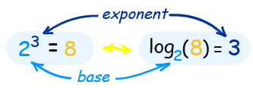
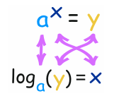
Exponents
Exponents and Logarithms are related, let's find out how ...
In that example the "base" is 2 and the "exponent" is 3:
The general case is:

Slide 8
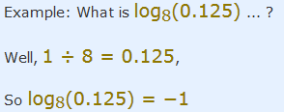
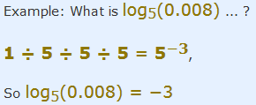
Negative Logarithms
We can have just divide like:

Slide 9
Introduction to Polynomials
Polynomials are algebraic expressions that are created by combining numbers and variables using arithmetic operations such as addition, subtraction, multiplication, division, and exponentiation. You can create a polynomial by adding or subtracting terms.
The word polynomial is derived from the Greek words ‘poly’ means ‘many’ and ‘nominal’ means ‘terms’, so altogether it said “many terms”. A polynomial can have any number of terms but not infinite. Learn about degree, terms, types, properties, polynomial functions in this seminar.

Slide 10

Example
An example of a polynomial with one variable is x² + x - 12. In this example, there are three terms: x², x and -12.
Polynomials are composed of:
Constants. Example: 1, 2, 3, etc.
Variables. Example: g, h, x, y, etc.
Exponents: Example: 5 in x⁵ etc.

Slide 11
Polynomial Notation
The polynomial function is denoted by P(x) where x represents the variable. For example,
P (x) = x² - 5x + 11
If the variable is denoted by a, then the function will be P (a).

Slide 12
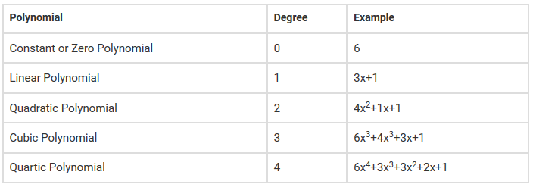
Degree of a Polynomial
The degree of polynomial is defined as the highest degree of a monomial within a polynomial. Thus, a polynomial equation having one variable which has the largest exponent is called a degree of the polynomial.

Slide 13

Terms of a Polynomial
Each part of a polynomial in an equation is a term. For example, in a polynomial, say, 2x² + 5 +4, the number of terms will be 3. The classification of a polynomial is done based on the number of terms in it.

Slide 14
Types of Polynomials
Monomial - contains only one term (Ex: 5x, 6, 6a⁴)
Binomial - contains exactly two terms (Ex: – 5x+3, 6a⁴ + 17x, xy²+xy)
Trinomial - contains exactly three terms (Ex: – 8a⁴+2x+7)

Slide 15
Polynomial Equations
The standard form of writing a polynomial equation is to put the highest degree first then, at last, the constant term. An example of a polynomial equation is:
b = a⁴ +3a³ -2a² +a +1

Slide 16
Solving Polynomials
The explanation of a polynomial solution is explained in two different ways:
Solving Linear Polynomials
Solving Quadratic Polynomials

Slide 17
Solving Polynomials
Solving Linear Polynomials: First, isolate the variable term and make the equation as equal to zero. Then solve as basic algebra operation.
First, rewrite the expression in the descending order of degree. Then, equate the equation and perform polynomial factorization to get the solution of the equation.

Slide 18
Polynomial Operations
There are four main polynomial operations which are:
Addition of Polynomials (add the like terms, i.e. the terms having the same variable and power)
Subtraction of Polynomials (similar to addition, the only difference being the type of operation)
Multiplication of Polynomials (Two or more polynomial when multiplied always results in a polynomial of higher degree)
Division of Polynomials (isn’t much different from division of numbers)

Slide 19
References
https://www.purplemath.com/modules/polydefs.htm
https://www.mathplanet.com/education/algebra-2/polynomial-functions/basic-knowledge-of-polynomial-functions
https://tutorial.math.lamar.edu/classes/alg/polynomials.aspx
https://www.livescience.com/50940-logarithms.html
https://www.khanacademy.org/math/algebra2/x2ec2f6f830c9fb89:logs/x2ec2f6f830c9fb89:log-intro/a/intro-to-logarithms
https://www.youtube.com/watch?v=ZvL9aDGNHqA

Slide 20
Done for Today
Thank You

